Slide 1
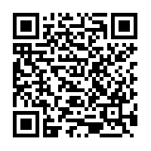

SIRE 2017 - Robotizing Domestic Home Based Healthcare: Can Robotics Enable Caregivers
Dr Tan Jit Seng
Lotus Technology
Lotus Eldercare Pte Ltd
@LEGeriatronics

Slide 2
Robotics – The “trojan” horse
IOT technology for tele monitoring is already here for a while, but services have yet to catch up.
Linking with services cannot be easier with multiple communication platforms.

Slide 3
The Loop of care
Caregiver
Health Services
Patient

Slide 4
Demonstration
Current possibilities – services which can be done today!

Slide 5

What’s there for tomorrow?
Automate the robotics – to follow care plans and do reminders of routine monitoring

Slide 6
What’s there for tomorrow?
Alert system – integration of continuous monitoring platforms using sounds or ultrasounds and having the control to seek out the patient immediately

Slide 7
What’s there for tomorrow?
Other possibilities
Integration with A.I. Chatbots – customized to each individual
www.chatbotsforhealth.com
Integration with exoskeletal robotics

Slide 8
Questions?
technology@lotuseldercare.com.sg
+65 6818 9512

