Slide 1
Elec.Net
Organising the world’s energy for the benefit of people and planet

Slide 2
DATA
Electricity Used in our everyday lives through our operation of household appliances

Slide 3
SORTED
Electricity usage is identified into each household appliances through their individual consumption patterns

Slide 4
ARRANGED
Location / Duration of usage /Time of use / Frequency of use of each household appliance can be tracked individually

Slide 5
Presented Visually
Usage of each household appliances tracked individually, with alarms set for each on the time of use, the duration of use and other requirements.
All the data can be presented remotely in a smartphone app.

Slide 6
Explained with a Story
Daily behaviour of the home dwellers can be tracked seamlessly, with a pattern of use (of each household appliance) identified.
Deviations of the behaviourial patterns can be flagged out and investigated earlier to better outcomes

Slide 7
The Internet of Energy
Inside the wiring of our buildings lies information about how we behave and how our world works.
By extracting that information and putting it on a cloud platform we create a new data set that has never existed before.

Slide 8
AI Electrical Switchboard Gathers granular information about occupant activity and appliance performance Accesses global energy data for analysis and reference

Slide 9
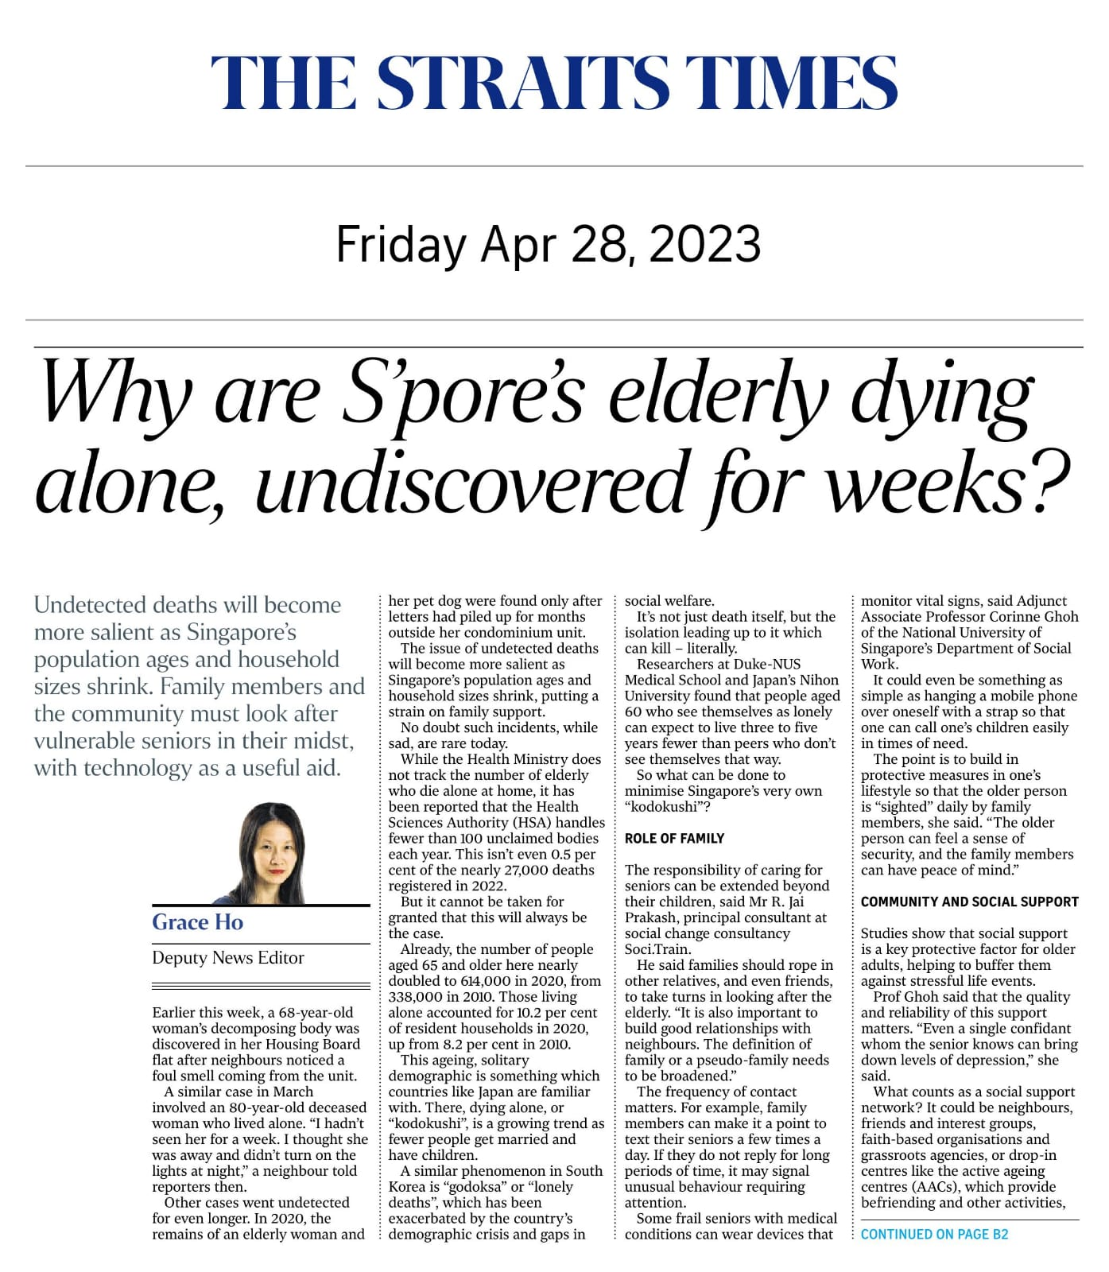

Slide 10
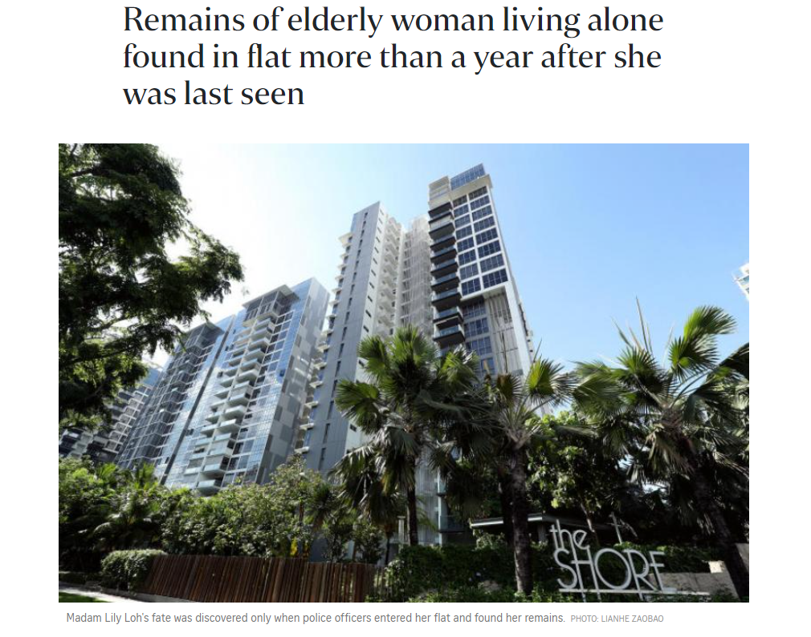
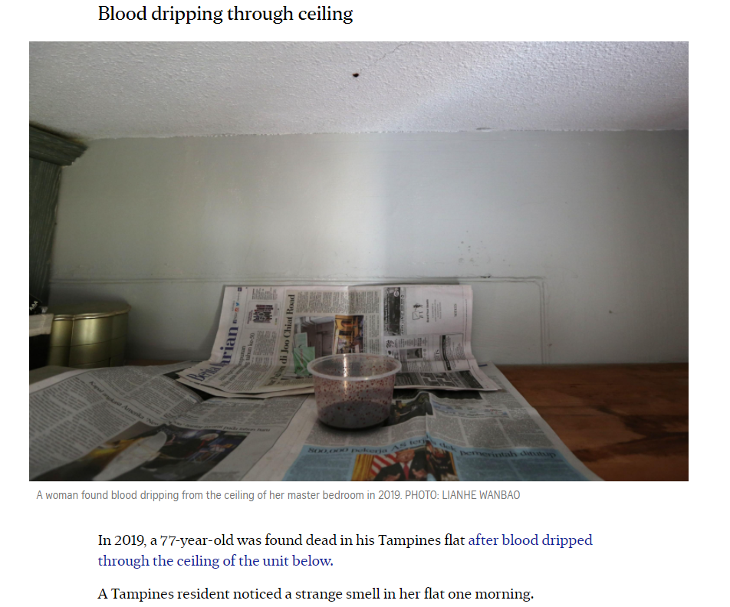
Use case #1 Earlier detection of inactivity in a household

Slide 11
Use Case #2
Monitoring physical activity in the home remotely and non-invasively for decline and potential dependency
Monitoring other potential medically relevant data sets, for example, number of visits to the toilet in the night for nocturia, hours of watching television etc.

Slide 12
Use Case #3 Monitoring for Electric Fires
HDB usually not equipped with water sprinklers
Older HDB flats with ageing wiring at risk of electric fires in homes
AVA can detect electrical arcing which starts fires

Slide 13
Use case #4
Understand Energy usage
= saves energy

Slide 14
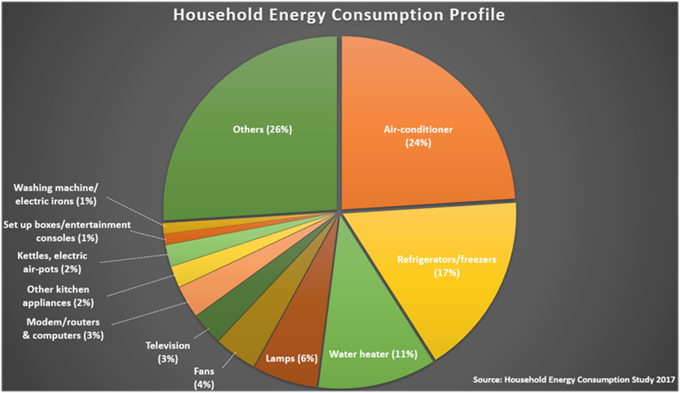

Slide 15
Advantages of Electricity based monitoring
24/7 monitoring with ability to have data monitored by A.I. algorithms and further A.I. learning
Cloud based and data can be shared by different organisations mining for different data sets – For example:
SCDF – monitoring for electric fires
Home Owners – monitoring for their appliances energy usage
Eldercare Services – monitoring for activity levels, inactivity in the home can trigger a visit or phone call
HDB – monitoring for faulty equipment such as lifts
Low cost compared to other forms of solutions needing to implement devices in multiple rooms
Totally nonintrusive : the device is attached outside the home
Non operator dependent, no wearables, no battery changes, no switching on/off devices etc

Slide 17
Dr Tan Jit Seng
Chief Medical Officer
Elec.net Singapore

